Slide 1
Principi e Pratiche applicative del Trattamento Psicofarmacologico nelle comorbidità psichiatriche e comportamentali nei Disturbi del Neurosviluppo
Luigi Croce

Slide 2
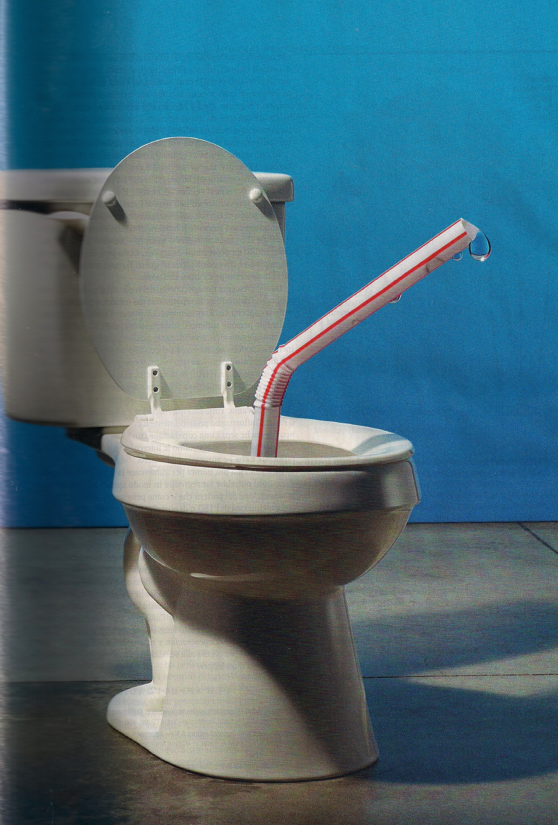
I Disturbi del Comportamento e la Psicopatologia nei Disturbi del Neurosviluppo: difficile da digerire…

Slide 3

Orienting
Psichotropic Drug Prescription in IDD: multimodal impact
Some suggestions from Literature
Towards a more integrated approach
Operational criteria to apprpriate prescribing
Ethical and relational issue
Clinical/Functional variables time profiling: an esemple (single case)
PD prescription and QoL: an exemple (group data)
Practical and operational indications
Conclusions

Slide 4

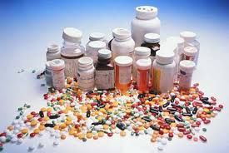


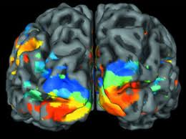

Prescribing: clinical, psychological, social impacts

Slide 5
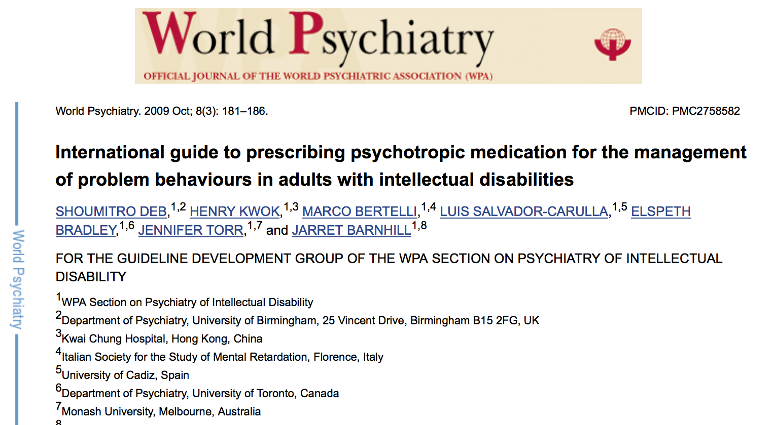
Indications and reccomendations from Literature

Slide 6
Reccomendations
Primary Care of Adults with Developmental Disabilities: Canadian Consensus Guidelines (2011)
Medications should be reviewed every three months, including indications, dosages, efficacy and side effects
Review the psychiatric diagnosis and the appropriateness of prescribed medications for this diagnosis whenever there is a behavior change.
Adults with IDD may be unable to communicate side-effects and may respond to psychotropic medications differently from those in the general population..
Reassess the need for ongoing use of antipsychotic medications at regular intervals and consider dose reduction or discontinuation when appropriate.

Slide 7
CBs: Reccomendations: using/not using
The exact situation under which medication and/or non-medication based management strategies should be implemented will depend on individual circumstances. Below are some of the situations under which the clinicians may consider using medication:
Failure of non-medication based interventions.
Risk/evidence of harm/distress to self.
Risk/evidence of harm/distress to others or property.
High frequency/severity of PB.
To treat an underlying psychiatric disorder or anxiety.
To calm the person to enable implementation of non-medication based interventions.
Risk of breakdown to the person’s placement.
Good previous response to medication.
Person/carer choice.
The lack of adequate or available non-medication based interventions should not be the only reason for using medication, although in practice this may happen. Under such circumstances, the medication should be used for as short a period as possible.

Slide 8
Reccomendations: Target CBs
A list of the target CB(s) to be managed.
A clear description of the CB, including frequency and severity.
An assessment of causes giving rise to the PB.
A record of reactions to and outcomes of the behaviour.
An evaluation of predisposing, precipitating and perpetuating risk factors.
Consideration of all management options and their outcome.
The rationale for the proposed management option.
A risk assessment for all the involved parties.
Possible benefits and adverse effects from the proposed intervention(s).
The likely effect of the proposed intervention(s) on the person’s and her/his family’s quality of life.
Using Functional Analysis also for Drug Treatment, considered as a system of contingencies

Slide 9
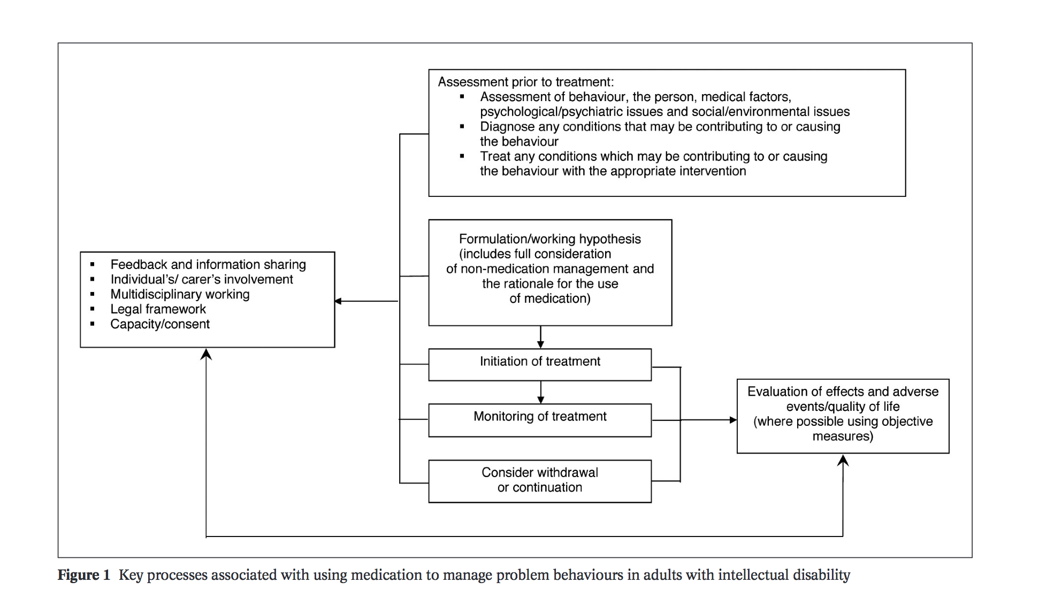
Flowchart operativa:

Slide 10
Prescribing Psychotropic Drugs for CBs in IDD
The importance of Guidelines
2000 | AAMR | “Expert Consensus Guidelines”
2004 | AAMR | “Update of the Expert Consensus Guidelines
2006 | S.Deb, D.Clarke and G.Unwin | “Using medication to manage behaviour problemamong adults with a learning disability”
2008 | G. Unwin, S.Deb e J.Bodfish | “Use of Medication for the Management of Behavior Problems among Adults with ID: a Clinicians’ consensus Survey”
2009 | J. de Leon, B. Greenlee, J. Barber, M. Sabaawi, N.N. Singh | “Pratical guidelines for the use of new generation antipsychotic drugs (except clozapine) in adult individuals with intellectual disabilities”

Slide 11
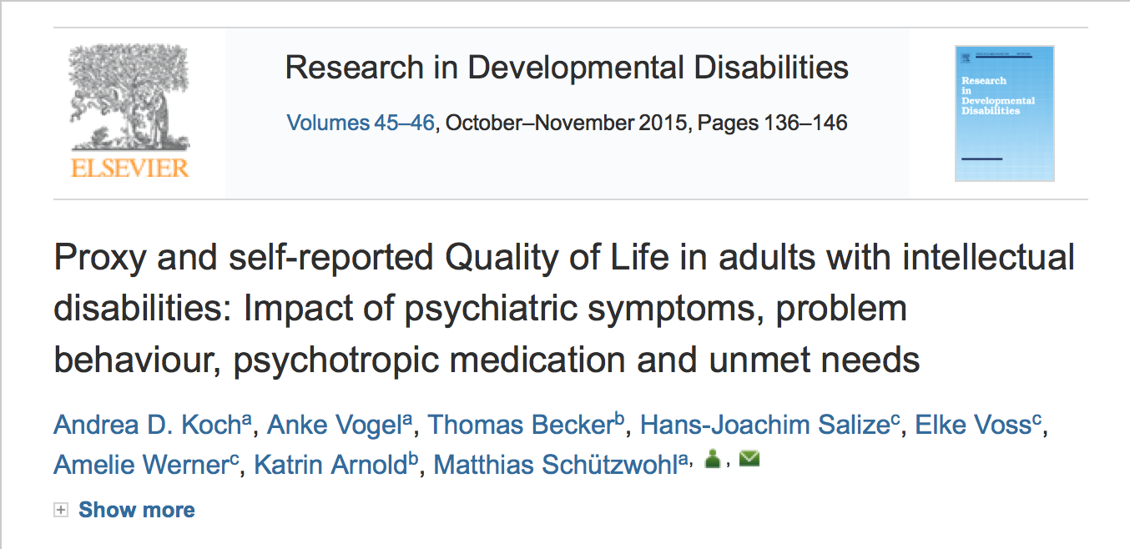
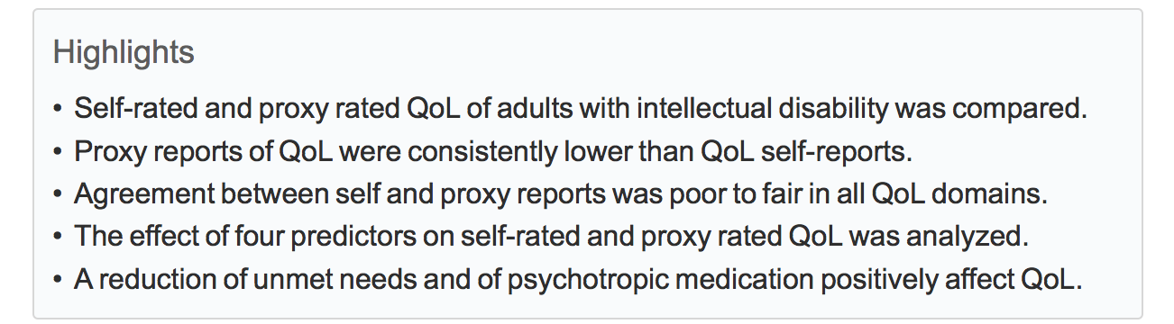

Slide 12
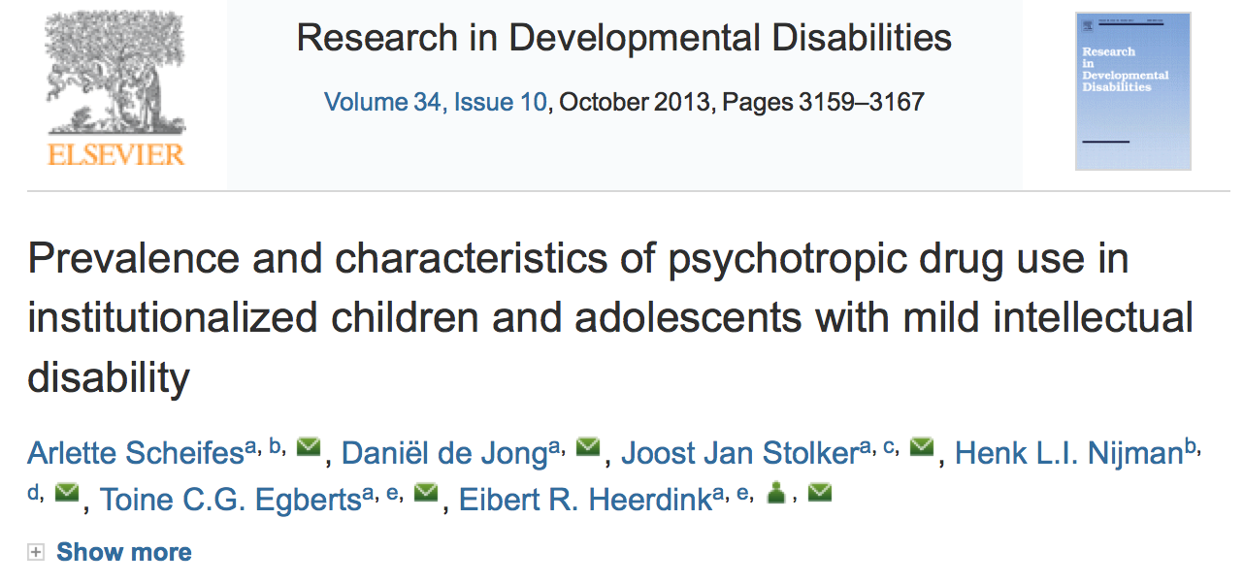
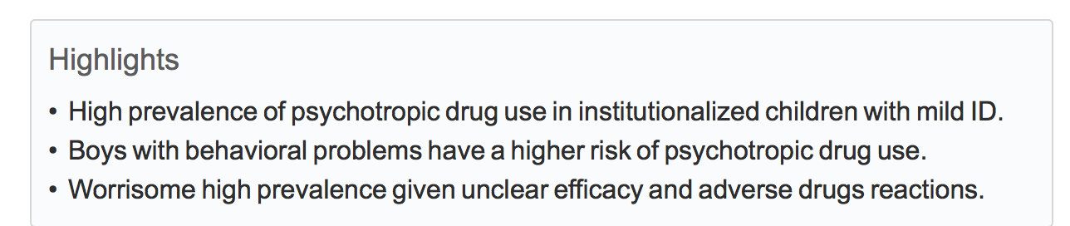

Slide 13
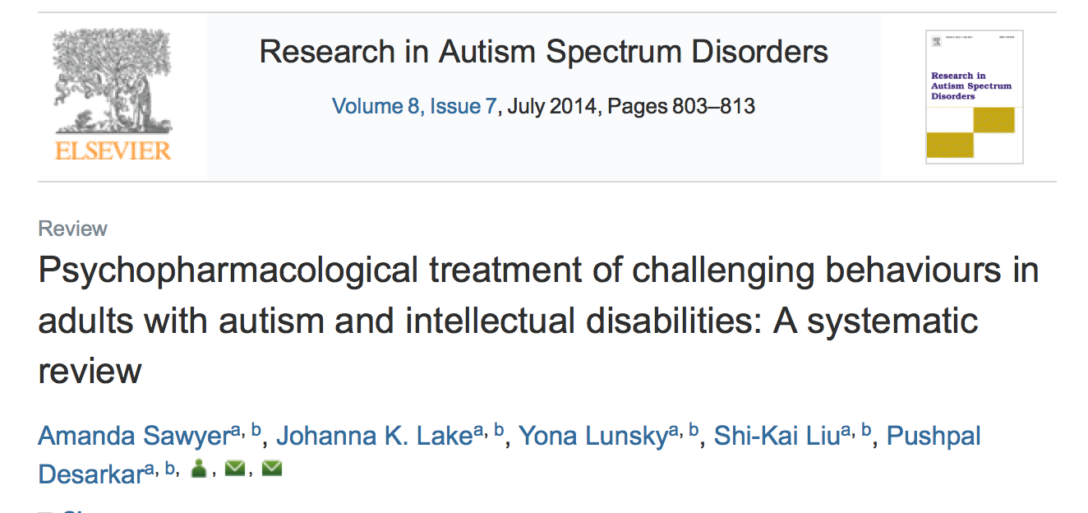
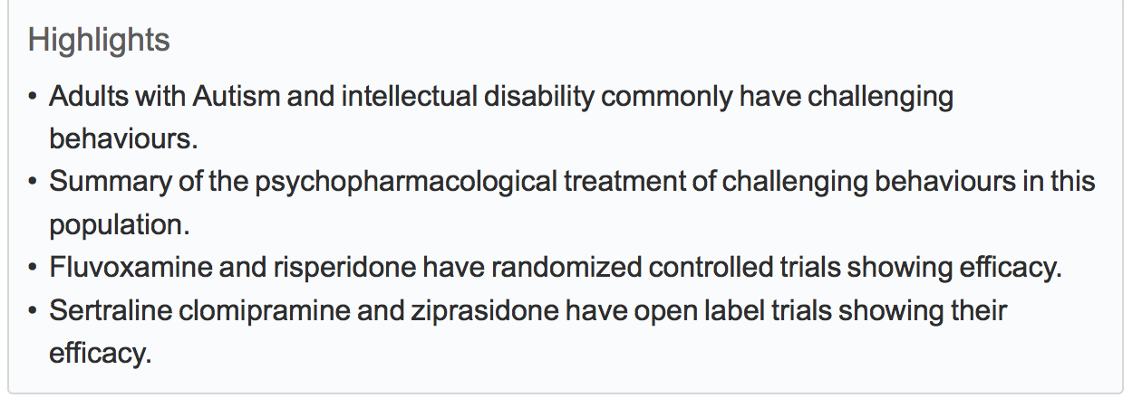

Slide 14
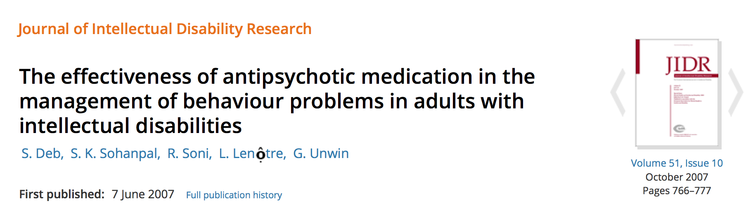
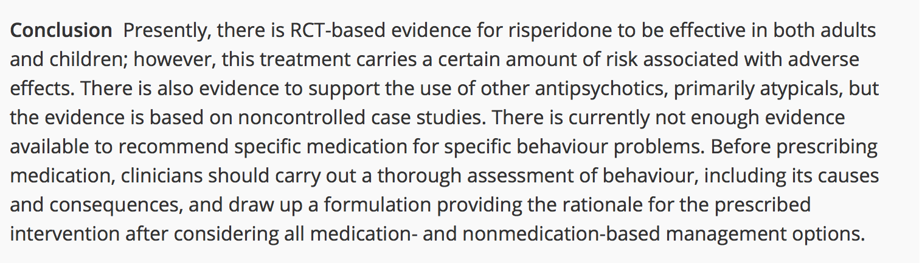

Slide 15
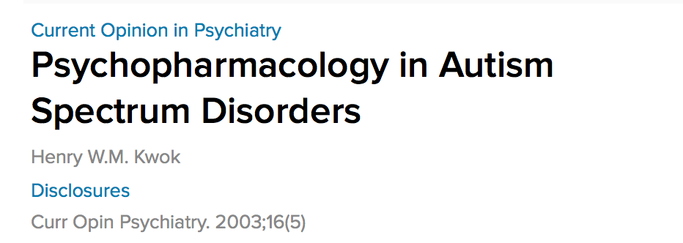
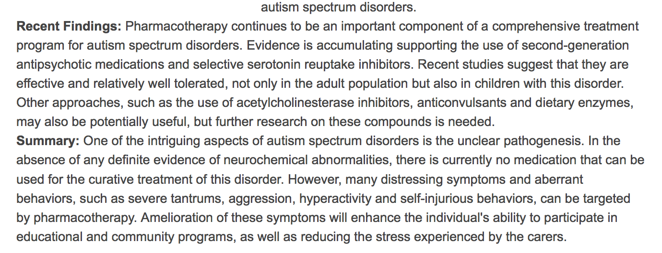

Slide 16
Literature and Experience: the paradimg of an intagrated approach
Integrated, Multimodal approach also in treatment and supports
INTEGRATED APPROACH to Intellectual and Developmental Disabilities can influence individual functioning, in terms of behavioural and psychiatric disorders and general mental health, and improve Quality of Life objective level.
Engel, 1977, 1980
Schalock, 1999
Wieseler, 1999
Siven, 2001
Dosen, 2005, 2007

Slide 17
10 principles and criteria: impact on psychopharmacology
Sharing information about assessment of the person’s condition in case of IDD, challenging behaviours and psychiatric disorders
Formalizing complete diagnostic ipothesis about the psychiatric and the behavioural components in actual and pregressive human functioning/clinical presentation
Implement Functional Analysis even to understand challenging behaviours derived from psychiatric conditions
Create a rational base for drug indication and prescription

Slide 18
10 principles and criteria: impact on psychopharmacology
Considering the option that a challenging behaviour might have more meanings in multiple contingencies context (internal and external)
Planning mdicine-clinical intervention and behavioural intervention on the basis of a rational and clinical and functional (complex) diagnostic ipothesis
Foreseeing the impacts of respectively pharmacological and behavioural intervention on challenging behaviours and psychopathological phenomenology, and the impact of their interaction
Conceptualize and Describe the dynamic interaction of metabolic and clinical drug effects with behavioural supports

Slide 19
10 principles and criteria: impact on psychopharmacology
Performing an active and integrated intervention
Evaluating any effect of reciprocal interaction between drug intervention and behavioural intervention (education, training, rehabilitation…)
Monitoring and measuring the outcomes of the combined intervention
Riciycling the process in case of poor inefficient outcomes of treatments and interventions
Monitorize and evaluate therapeutic and side effects of drug administration on clinical, functional and personal (quality of life) outcomes

Slide 20
Conceptualizing the Impact of Psychopharmacology ,Croce 2016…
Liberamente ricavato da
M. Pilone (1997)
Bio-psychic Vulnerability
Psychotropic Drugs
PRECIPITATING FACTORSI
Es.: environmental, educational, social,
relational Variables
External Feedback
Environment/Context
A
B C
Internal Feedback
D
E
Stimulus Situation:
-Internal antecedents
recent/remote
- External antecedents
recent/remote
Sensorial and Cognitive Filter:
- Stimuli perception
- Internal Constructs and Representations
- Previous learningi
Reality model
Values
etc.
Emtion related responses:
- Emotional responses
- Physiologcal responses
Explicit behavioural response
verbal
motor
Environmental Consequences:
- Positive reinforcement
- Negative reinforcement
- Punisment
PREDISPOSING FACTORS
Es:Diseases, syndromes
, pre-menstrual syndrome, Pain,
Prostration.Hunger, Thirst, Drugs,
Cognitive deficits
, Communication deficits,
Social and Relationships deficits
MAINTAINANCE FACTORS
Es.:Environmental responses
to CB mainteinance
-Enricment
Avoidance
PROTECTION FACTORS
Es.: Personal strenghts,
Iso-functiona, acceptable
behaviours

Slide 21


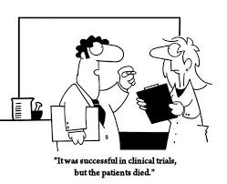
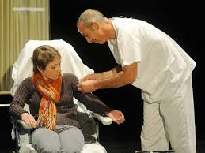
Don’t Forget…
Drug administration is a relational and ethical issue
Drug admistration is a complex behaviour and a great and a very important source of information

Slide 22

Towards operalization
Classifying information, monitoring variables, controlling contingencies

Slide 23
COMPORTAMENTI AL MESE
(VARIABILE INDIPENDENTE)
COMPORTAMENTI ESPRESSI IN FREQUENZA
COMPORTAMENTI ESPRESSI IN ORE

Slide 24
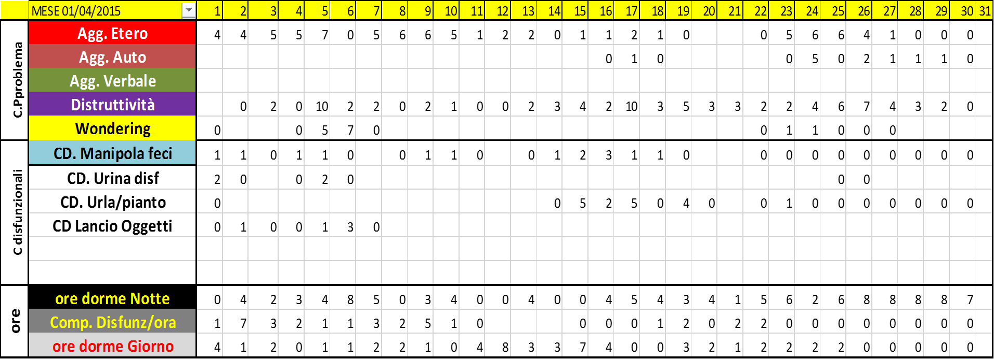
INTERVENTO PSICOEDUCATIVO..
DISEGNO SPERIMENTALE A……. (A-B)
INTERVENTO PSICOEDUCATIVO..
DISEGNO SPERIMENTALE B……. (A-B)
PRIMA VARIABILE DIPENDENTE:
INTERVENTO PSICOEDUCATIVO
(IN DISEGNO SPERIMENTALE A-B)

Slide 25
INTERVENTO FARMACOLOGICO..
Modificazione a
INTERVENTO FARMACOLOGICO..
Modificazione b
SECONDA VARIABILE DIPENDENTE:
INTERVENTO FARMACOLOGICO
()

Slide 27
LINEA/AREA IN DECREMENTO

Slide 30
Suggestions
It is not enough to declare the aim to collaborate
Psychiatrists and Educators need to share and implement systematycally and continuously the same operational platform (graphs…)
Monitoring variables development along time should be a collaborative task
Learning together from monitoring common experience is a mean and a way to control complexity and pursue efficiency, efficacy and sustainability of best treatment
Looking for the “magic combination” is not a myth

Slide 31
Obiettivi del Trattamento

Slide 32
Child Adolesc Psychiatric Clin N Am 21 (2012) 957–973
http://dx.doi.org/10.1016/j.chc.2012.07.006 childpsych.theclinics.com 1056-4993/12/$ – see front matter ! 2012 Elsevier Inc. All rights reserved.

Slide 33
Pediatr Clin N Am 59 (2012) 175–187
doi:10.1016/j.pcl.2011.10.005

Slide 34
Pediatr Clin N Am 59 (2012) 175–187
doi:10.1016/j.pcl.2011.10.005 pediatric.theclinics.com 0031-3955/12

Slide 42
Aggressività: dati epidemiologici

Slide 44
Cause di Aggressività in DSA

Slide 45
Trattamento dell’Aggressività

Slide 49
Iperattività e Impulsività

Slide 50
Comportamenti ripetitivi

Slide 51
Psicostimolanti

Slide 53
SSRI

Slide 54
Stabilizzatori dell’Umore

Slide 55
Benzodiazepine: ATTENZIONE!

Slide 56
Melatonina:

Slide 60
Linee Guida per l’uso dei Farmaci in DSA
Alessandro Zuddas 2014

Slide 63


Slide 64
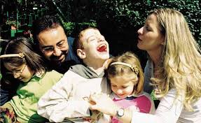
Contatto:
luigi.croce@unicatt.it
tel. +39 338 6669006

