Slide 1
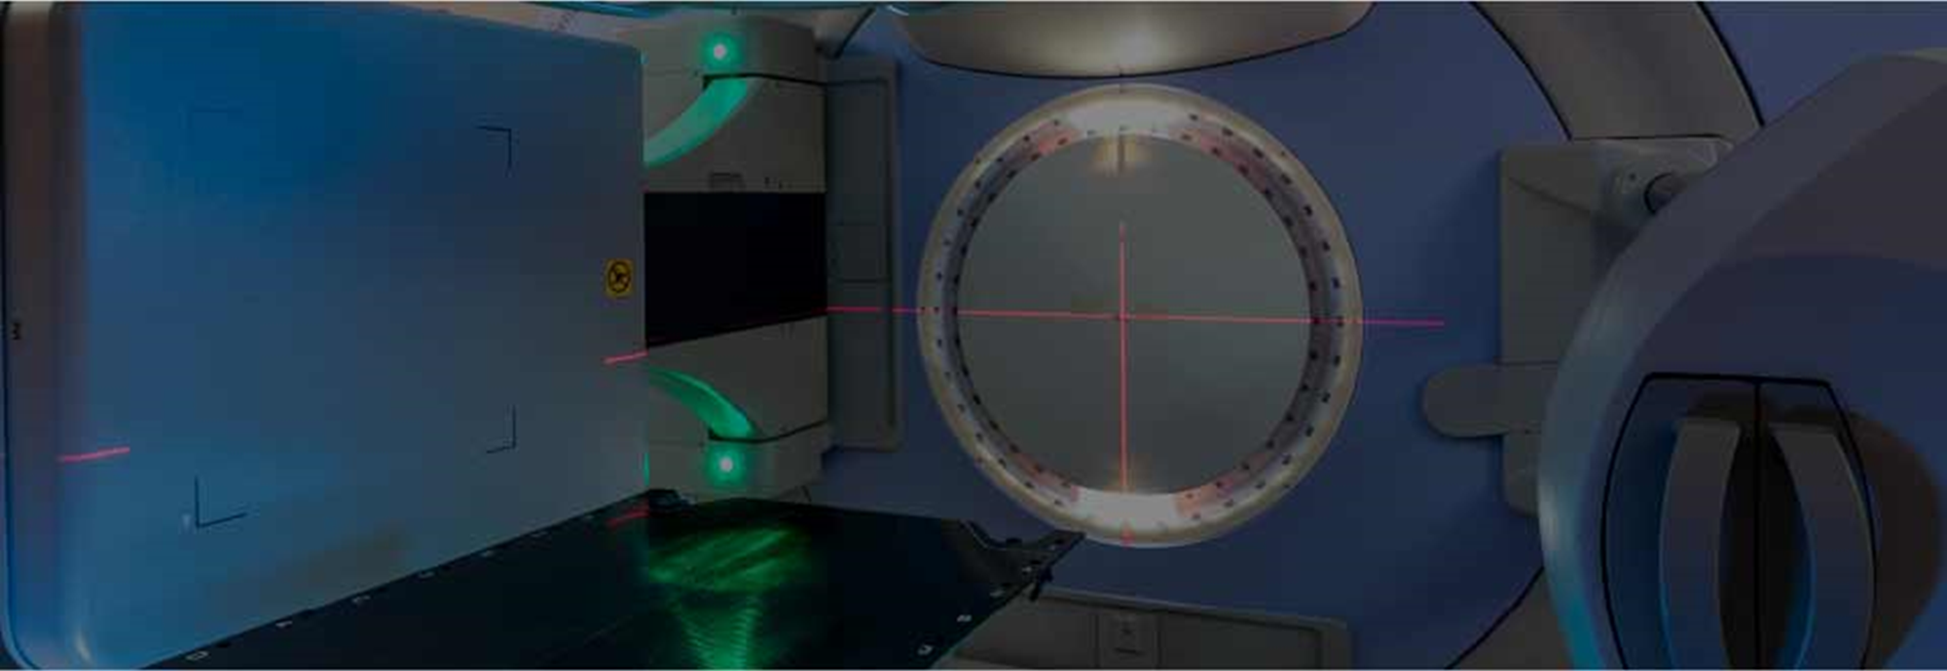
La Medicina che cambia
Anamnesi ed esame obiettivo
al tempo della tecnomedicina
Brescia 8 Aprile 2017
Tony Sabatini – Fondazione Poliambulanza Istituto Ospedaliero- Brescia

Slide 2
FROM THE EDITOR
Blending classic clinical skills with new technology
Cleveland Clinic Journal of Medicine. 2017 April;84(4):266-267
Brian F Mandell, MD, PhD

Slide 3
“Now that we can order MRI studies on a break from rounds walking to Starbucks, utilize portable ultrasounds to direct IV line placement, and use dual-energy CT to detect a gout attack that has not yet occurred, it seems like a romantic anachronism to extol the ongoing virtues of the seemingly lost art of the physical examination”
Ora che possiamo ordinare una RM durante una pausa mentre stiamo andando a Starbucks (Caffè), possiamo utilizzare l’ecografia per incannulare una vena, e possiamo usare dual energy CT (DECT) per individuare attacchi di gotta prima che si verifichino…..
…..sembra un romantico anacronismo esaltare le virtù di quell’arte, apparentemente perduta, che è rappresentata dall’esame obiettivo

Slide 4
“the most common recognized diagnostic error related to the physical examination is that the appropriate examination isn’t done”
Il più comune errore diagnostico correlato all’esame obiettivo è che spesso un appropriato esame obiettivo non viene effettuato !!
From : Verghese A, Charlton B, Kassirer JP, Ramsey M, Ioannidis JP. Inadequacies of physical examination as a cause of medical errors and adverse events: a collection of vignettes. Am J Med 2015; 128:1322–1324.

Slide 5
«The blending is the challenge»
La combinazione è la sfida
.

Slide 6
EDITORIAL
When the tail wags the dog: Clinical skills in the age of technology
Cleveland Clinic Journal of Medicine. 2017 April;84(4):278-280
Salvatore Mangione, MD
Associate Professor of Medicine, Sidney Kimmel Medical College of Thomas Jefferson University, Philadelphia, PA

Slide 7
“... with the rapid extension of laboratory tests of greater accuracy, there is a tendency for some clinicians and hence for some students in reaching a diagnosis to rely more on laboratory reports and less on the history of the illness, the examination and behavior of the patient and clinical judgment. While in many cases laboratory findings are invaluable for reaching correct conclusions,
the student should never be allowed to forget that it takes a man, not a machine, to understand a man.”
—Raymond B. Allen, MD, PhD, 1946¹

